Slide 1
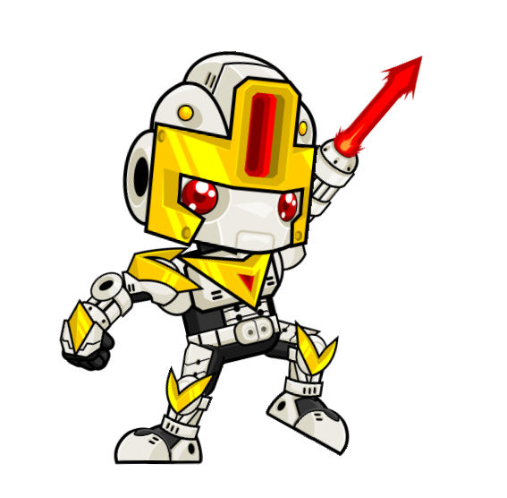
Dungeon Bot
The journey of a robot looking for treasures in the ancient ruins

